Slide 1
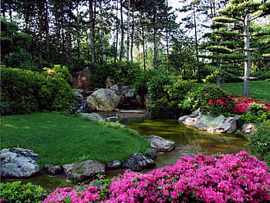
Teaching Team
Mrs Johnson with Mrs Gill at the start of term and Mrs Clairehugh joining in May but we will also be supported by…
Mr Moloney and Mrs Smith as well as Andrea and Jillian in Preschool!
Alnwick Castle Class Newsletter -
Summer 1
Dear Parents / Carers,
Welcome back to the start of our summer term and we hope you have had a wonderful Easter break. Our next theme ‘The Great Outdoors’ will be exploring our diverse world. We will have lots of exciting activities and fun learning adventures including outdoor days. We will continue to post regularly what we have been up to on Tapestry but please also remember the website has lots of other useful information on too (www.hipsburn.northumberland.sch.uk).
Reminders
Thursday - Please come dressed in PE kits
Friday - Celebration Assembly
Please bring water bottles everyday and keep reading books in book bags each day too so they are always available to read. Even though it is meant to be Summer - please bring in wellies and waterproofs so we can enjoy the outdoors no matter what the weather does!
Areas of Learning
This half term we will be exploring plants and living things. This will provide us with lots of opportunities to get outdoors and hands on with nature. We will learn that plants are living things, where they come from and how to look after them. We will also learn about insects and invertebrates, investigating where they live and how important they are to the world around us.
We will be sharing and writing about stories such as The Hungry Caterpillar, Katie’s Sunflower, Jasper’s Beanstalk and Oi Frog. Through these stories we will be looking to expand our vocabulary as well as inspire our imaginations and creativity when writing and storytelling. We will be continuing with our daily Read Write Inc. phonics and we will recap Set 2 sounds, mainly digraphs (when two letters make one sound) and trigraphs (when three letters make one sound) whilst continuing to develop skills in phoneme recognition and decoding words.
In Maths we will be applying the counting principles to 20 and Beyond (Building numbers beyond 10, Counting patterns beyond 10, adding and taking away) and develop our understanding of measure with lots of opportunities to apply these skills through our play.
To support our Personal, Social and Emotional development, we will be thinking about feelings and relationships. Children will develop their ability to deal with feelings in a positive way, share opinions and explain their own views, set individual goals and listen and play with others cooperatively.
It will be a busy outdoor exploring half term ahead!

